Slide 1
Review For Final Exam ==================== I-សំណួរ ៣០ពិន្ទុ

Slide 2
Chapter7:Configuring File Servers ~Understanding Samba (Windows File Server)~
Notes:
Samba is a open source software.
Samba uses TCP/IP protocol.
Samba is Linux implementation of SMB/CIFS protocols.
Samba allows interoperability between Linux and Window.
Samba provide file and print sharing service between Linux and Window system.
Samba allows Linux to interact with Window client, Server, member of Active Directory, Primary domain controller, or member server.
Samba support Microsoft Access Control Lists.
Main configuration file of Samba server is /etc/samba/smb.conf
Samba Web Administration tool (SWAT) is a GUI base configuration tool for Samba

Slide 3
Samba Installation
Installing from rpm
rpm –ivh samba.x.x.x.rpm --nodeps
rpm –ivh samba-common.x.x.x.rpm --nodeps
rpm –ivh samba-client.x.x.x.rpm --nodeps
rpm –ivh samba-winbind.x.x.x.rpm --nodeps
Online install from YUM
# yum install samba samba-common samba-client samba-winbind
Notes:
Samba installation :
After installing Centos 6 and configuring network. Step 1 » Update yum repositories and packages by typing the below command; [root@localhost ~]# yum update
Step 2 » Install samba packages along with dependencies using yum; [root@localhost ~]# yum install samba
Samba-client and Samba-common are installed by default
-rpm –ivh system-config-samba-doc.x.x.x.rpm (no need dependency)

Slide 4
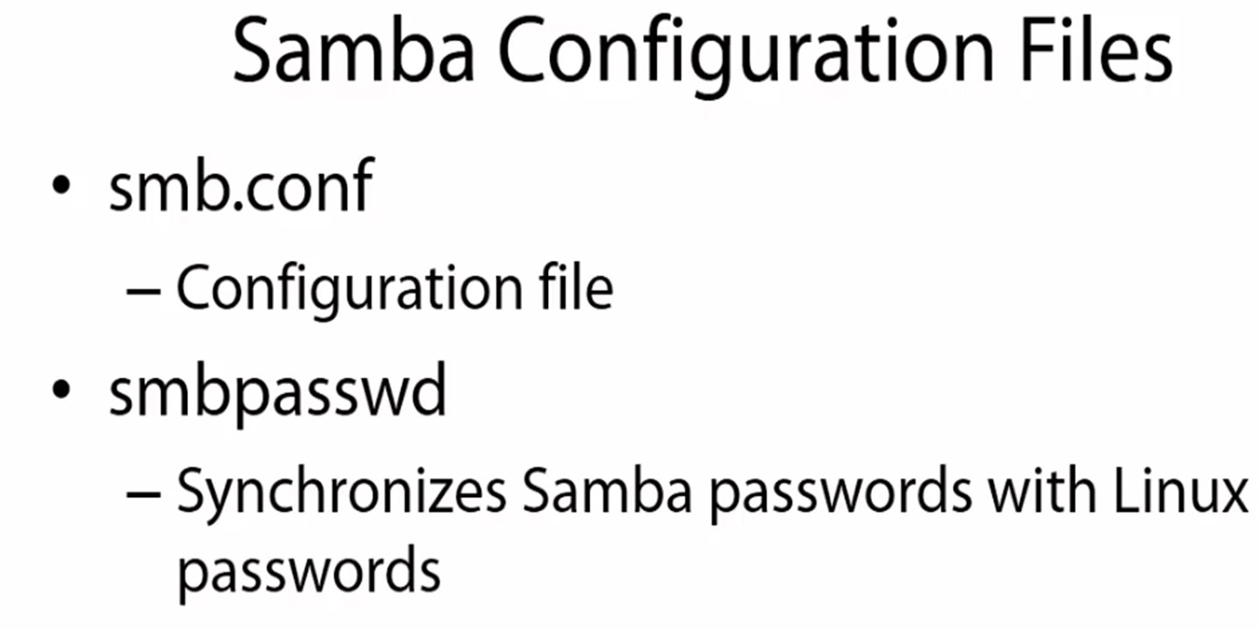
Samba Configuration
Notes:
Samba configuration is done in the file /etc/samba/smb.conf. There are two parts to /etc/samba/smb.conf:
1. Global Settings: This is where you configure the server. You’ll find things like authentication method, listening ports, interfaces, workgroup names, server names, log file settings, and similar parameters.
2. Share Definitions: This is where you configure each of the shares for the users. By default, there’s a printer share already configured.

Slide 5
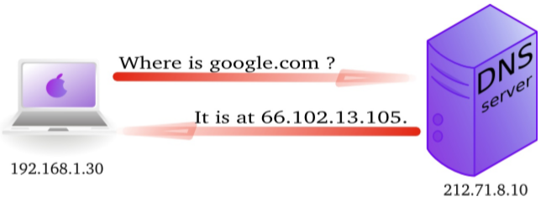
Chapter8-Configuring DNS Servers
Introduction
Domain Name System (DNS) is an Internet service that converts a fully qualified domain name, such as www.google.com, into its corresponding IP address, such as 66.102.13.105. You can think of DNS as the directory of Internet hosts — DNS is the reason why you can use easy-to-remember hostnames even though TCP/IP requires numeric IP addresses for data transfers.

Slide 6
BIND includes three major components:
✦ The named daemon (the name server), which responds to queries about hostnames and IP addresses
✦ A resolver library (DNS client resolution) use on all Unix base system to resolve host queries by contacting the servers of DNS distributed database
✦ Command-line DNS utility programs, such as dig (Domain Internet Groper) and host, that users can use to query DNS
Notes:
A resolver library that applications can use to resolve hostnames into IP addresses (and vice versa)

Slide 7
DNS Zones
A DNS zone is the specific portion of a DNS namespace (such as adatum.com) that contains DNS records, also called resource records.
A DNS zone is hosted on a DNS server that is responsible for responding to queries for records in a specific domain.
For example, the DNS server that is responsible for resolving www.adatum.com to an IP address would contain the adatum.com zone.

Slide 8
DNS Zones
Zone types
1. Forward lookup zones: resolve host names to IP addresses.
2. Reverse lookup zones: resolve IP addresses to domain names.

Slide 9
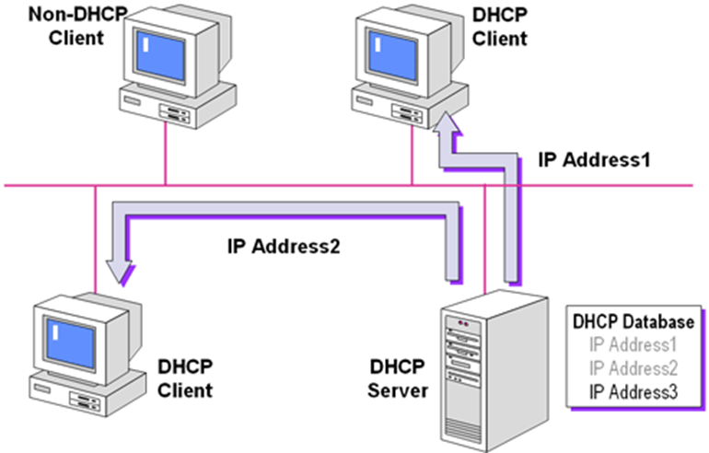
Chapter09:Configuring DHCP Servers
~Overview of the DHCP Server~
DHCP is a standard developed to enable host systems in a TCP/IP network to be configured automatically for the network as they boot. DHCP uses a client/server mechanism: servers store and manage configuration information for clients, and provide that information upon a client's request. The information includes the client's IP address and information about network services available to the client.

Slide 10
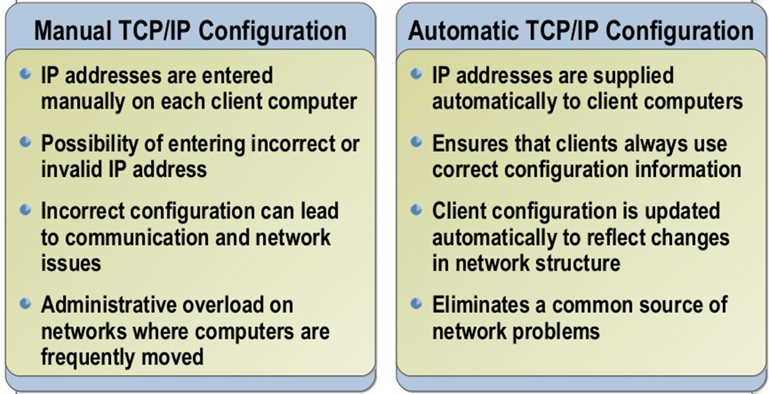
~Benefits of Using DHCP~
DHCP reduces the complexity and amount of administrative work by using automatic TCP/IP configuration
Notes:
Save IP usage; Easy to Manage; Can avoid from human errors with manual ip assign; No or minimum IP conflicts in Network; DHCPv6 Support; More Efficient for Mobile Users; Network changes can apply more easily and faster

Slide 11
Chapter11: Apache Web Server
Introduction
The Apache HTTP Server (Apache) is an open-source web server application.
A web server is a computer program that serve the web pages to the client on request.
Web server are used to publish the web pages on the internet or intranet.
It listen for pages request from the client.
It examines my page request. It received and response with the request pages
Notes:
This guide explains how to install and configure an Apache web server on CentOS 6.
If instead you would like to install a full LAMP (Linux, Apache, MySQL, and PHP) stack, please see the LAMP on CentOS 6 guide. A LAMP (Linux, Apache, MySQL, PHP) stack is a common web stack used to prepare servers for hosting web content.

Slide 12
II-លំហាត់ ៣០ពិន្ទុ =================================== 1-Name Based Virtual Hosting(http & https) 2-Primary DNS 3-DHCPv4

